Slide 1
Computer Vision and Deep Learning
Lecture 7

Slide 2
Today’s agenda
Self-attention example
Attention is all you need
Position encodings, embeddings
Vision transformers
Vision transformer
DeiT
Swin Transformer

Slide 3
Attention intuition
https://youtu.be/XfpMkf4rD6E?t=1213

Slide 4
Self-attention
https://peterbloem.nl/blog/transformers

Slide 5
Self-attention
scaled dot product
key, value and query transformations
multi-head attention

Slide 6
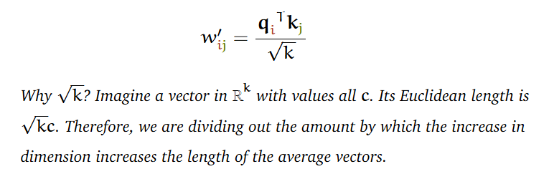
Self-attention
Scale the dot product
softmax function is sensitive to very large input values
the average value of the dot product grows with the embedding dimension k, then scale the dot product back a little to reduce the inputs of softmax function

Slide 7
Self-attention
Scale the dot product
Key, value and query transformation
Each input vector has three different roles
the value: the vector that is used in the weighted sum that ultimately provides the output.
the query: the input vector that corresponds to the current output, matched against every other input vector.
the key: the input vector that the query is matched against to determine the weight.
Multiply each input vector by three different k-by-k parameter matrices, which gives us a different vector to act as key query and value

Slide 8
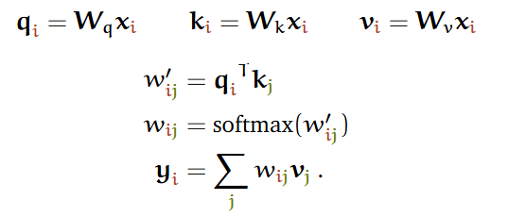
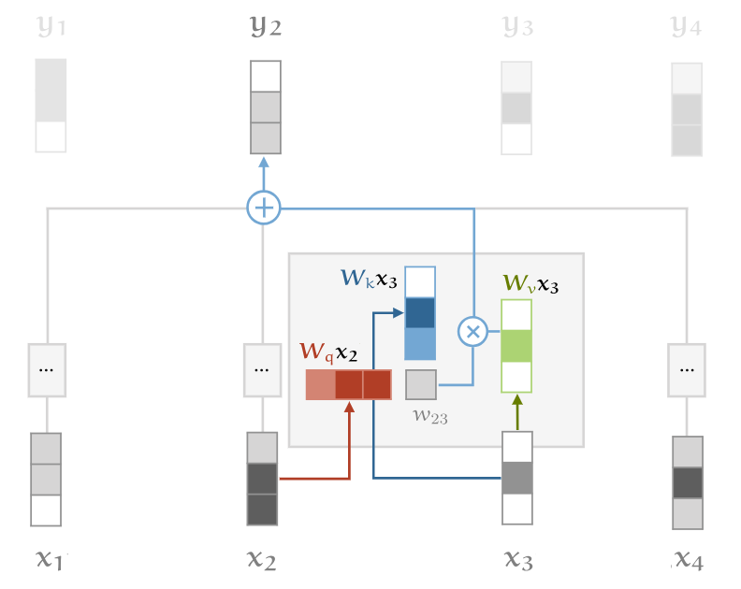
Self-attention

Slide 9
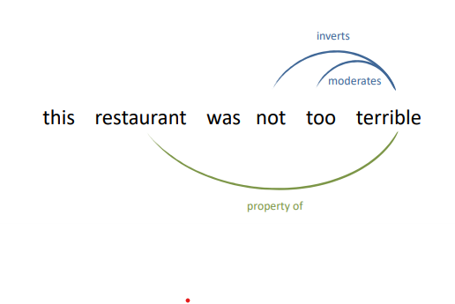
Self-attention
Scale the dot product
Key, value and query transformation
Multi-head attention
multiple relations are best captured by different self-attention operations.

Slide 10
Self-attention
Naïve version: apply in parralel, then concatenate
apply a small number of copies of the self-attention mechanism in parallel, each with their own key, value and query transformation
h heads, operation is h as slow
In practice:
each head receives low-dimensional keys queries and values.
If the input vector has k=256 dimensions and h=4 attention heads
multiply the input vectors by a 256×64 matrix to project them down to a sequence of 64 dimensional vectors
for every head, we do this 3 times: for the keys, the queries and the values.

Slide 11
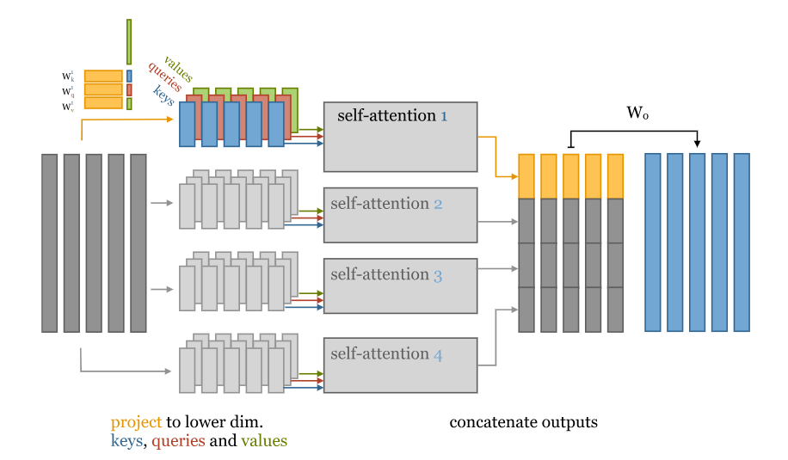
Self-attention
3h matrices of size k by k/h
In total: 3hk(k/h)=3k² parameters to compute the inputs to the multi-head self-attention

Slide 12
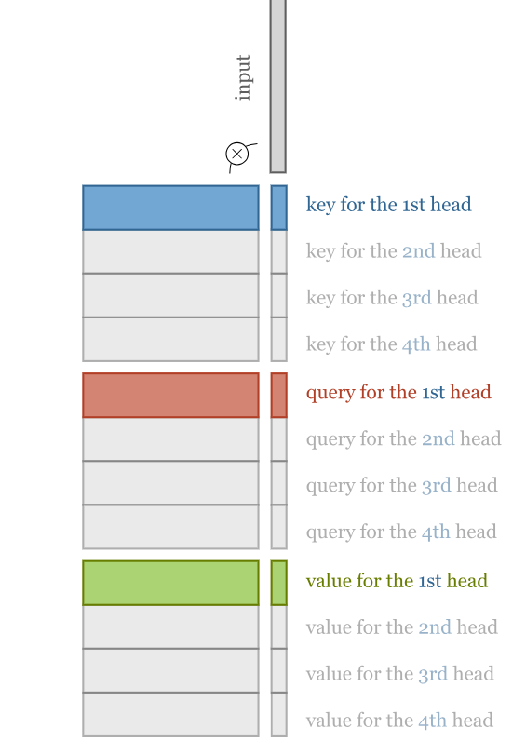
Self-attention
Combine the computation of the projections down to a lower dimensional representation and the computations of the keys, queries and values into three k×k matrices
Just like in a single self attention

Slide 13
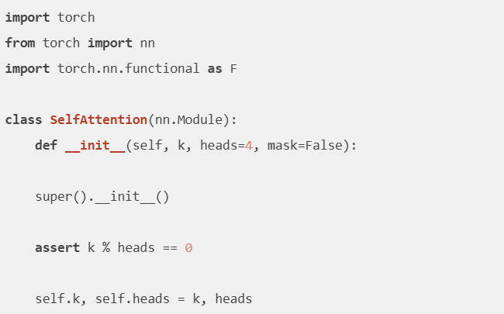
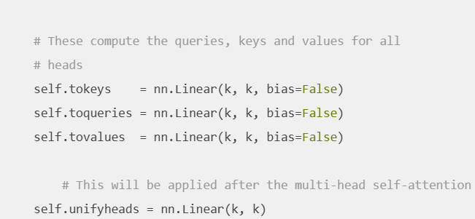
Self-attention

Slide 14
def forward(self, x): b, t, k = x.size() h = self.heads queries = self.toqueries(x) keys = self.tokeys(x) values = self.tovalues(x) s = k // h keys = keys.view(b, t, h, s) queries = queries.view(b, t, h, s) values = values.view(b, t, h, s) # - fold heads into the batch dimension keys = keys.transpose(1, 2).contiguous().view(b * h, t, s) queries = queries.transpose(1, 2).contiguous().view(b * h, t, s) values = values.transpose(1, 2).contiguous().view(b * h, t, s) # Get dot product of queries and keys, and scale dot = torch.bmm(queries, keys.transpose(1, 2)) # -- dot has size (b*h, t, t) containing raw weights # scale the dot product dot = dot / (s ** (1 / 2)) # normalize dot = F.softmax(dot, dim=2) # - dot now contains row-wise normalized weights # apply the self attention to the values out = torch.bmm(dot, values).view(b, h, t, s) # swap h, t back, unify heads out = out.transpose(1, 2).contiguous().view(b, t, s * h) return self.unifyheads(out)
compute the queries, keys and values for all heads -> three vector sequences of the full embedding dimension k.

Slide 15
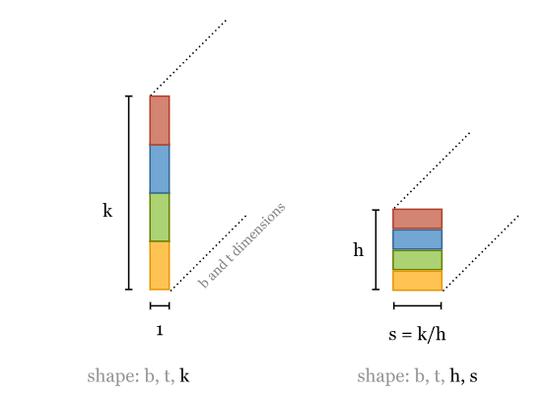
def forward(self, x): b, t, k = x.size() h = self.heads queries = self.toqueries(x) keys = self.tokeys(x) values = self.tovalues(x) s = k // h keys = keys.view(b, t, h, s) queries = queries.view(b, t, h, s) values = values.view(b, t, h, s) # - fold heads into the batch dimension keys = keys.transpose(1, 2).contiguous().view(b * h, t, s) queries = queries.transpose(1, 2).contiguous().view(b * h, t, s) values = values.transpose(1, 2).contiguous().view(b * h, t, s) # Get dot product of queries and keys, and scale dot = torch.bmm(queries, keys.transpose(1, 2)) # -- dot has size (b*h, t, t) containing raw weights # scale the dot product dot = dot / (s ** (1 / 2)) # normalize dot = F.softmax(dot, dim=2) # - dot now contains row-wise normalized weights # apply the self attention to the values out = torch.bmm(dot, values).view(b, h, t, s) # swap h, t back, unify heads out = out.transpose(1, 2).contiguous().view(b, t, s * h) return self.unifyheads(out)
Cut these vectors into h chunks

Slide 16
def forward(self, x): b, t, k = x.size() h = self.heads queries = self.toqueries(x) keys = self.tokeys(x) values = self.tovalues(x) s = k // h keys = keys.view(b, t, h, s) queries = queries.view(b, t, h, s) values = values.view(b, t, h, s) # - fold heads into the batch dimension keys = keys.transpose(1, 2).contiguous().view(b * h, t, s) queries = queries.transpose(1, 2).contiguous().view(b * h, t, s) values = values.transpose(1, 2).contiguous().view(b * h, t, s) # Get dot product of queries and keys, and scale dot = torch.bmm(queries, keys.transpose(1, 2)) # -- dot has size (b*h, t, t) containing raw weights # scale the dot product dot = dot / (s ** (1 / 2)) # normalize dot = F.softmax(dot, dim=2) # - dot now contains row-wise normalized weights # apply the self attention to the values out = torch.bmm(dot, values).view(b, h, t, s) # swap h, t back, unify heads out = out.transpose(1, 2).contiguous().view(b, t, s * h) return self.unifyheads(out)
batch, seq_len, heads, head_dim, i.e. b, t, h, s
.transpose(1, 2) -> swaps seq_len and heads
(b, t, h, s) → (b, h, t, s)
Data is not contiguous, use .contiguous() to physically reorder the data
.view(b * h, t, s) -> merge the batch and head dimensions
Treat each head as an independent batch element, so torch.bmm can process all heads in parallel in one call

Slide 17
def forward(self, x): b, t, k = x.size() h = self.heads queries = self.toqueries(x) keys = self.tokeys(x) values = self.tovalues(x) s = k // h keys = keys.view(b, t, h, s) queries = queries.view(b, t, h, s) values = values.view(b, t, h, s) # - fold heads into the batch dimension keys = keys.transpose(1, 2).contiguous().view(b * h, t, s) queries = queries.transpose(1, 2).contiguous().view(b * h, t, s) values = values.transpose(1, 2).contiguous().view(b * h, t, s) # Get dot product of queries and keys, and scale dot = torch.bmm(queries, keys.transpose(1, 2)) # -- dot has size (b*h, t, t) containing raw weights # scale the dot product dot = dot / (s ** (1 / 2)) # normalize dot = F.softmax(dot, dim=2) # - dot now contains row-wise normalized weights # apply the self attention to the values out = torch.bmm(dot, values).view(b, h, t, s) # swap h, t back, unify heads out = out.transpose(1, 2).contiguous().view(b, t, s * h) return self.unifyheads(out)
transpose again, so that the head dimension and the embedding dimension are next to each other, and reshape to get concatenated vectors of dimension e.
pass these through the unifyheads (Linear(k, k)) layer for a final projection.

Slide 18
Positional Encodings
“Words” in a sentence simultaneously flows through the Transformer’s encoder/decoder stack
The model itself doesn’t have any sense of position/order for each word
Incorporate token order
Unique encoding for each time-step (word’s position in a sentence).
Distance between any two time-steps should be consistent across sentences with different lengths.
Generalize to longer sentences without any efforts.
Bounded values.
It must be deterministic.

Slide 19
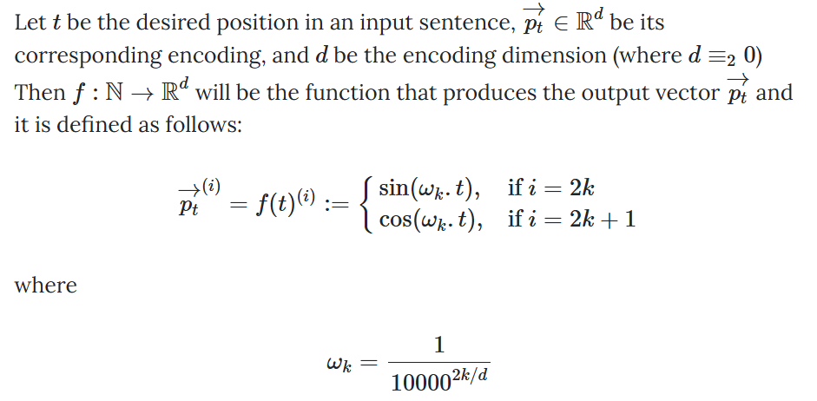
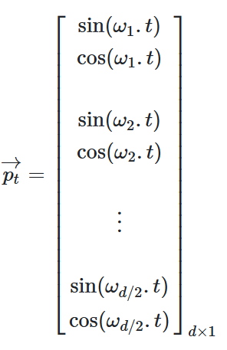
Positional Encodings
Frequencies decrease along the vector dimension.
Geometric progression from 2π to 10000⋅2π on the wavelengths.
https://kazemnejad.com/blog/transformer_architecture_positional_encoding/

Slide 20
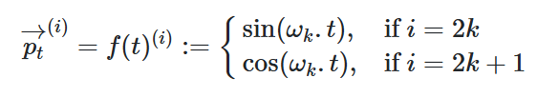

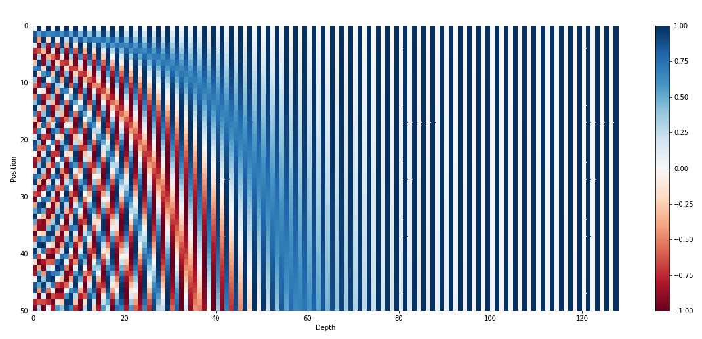
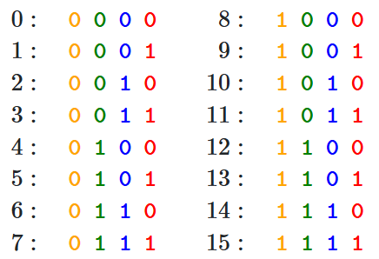
Positional Encodings Intuition
https://kazemnejad.com/blog/transformer_architecture_positional_encoding/

Slide 21
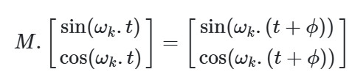
Positional Encodings
“We chose this function because we hypothesized it would allow the model to easily learn to attend by relative positions, since for any fixed offset k, PE_{pos+k} can be represented as a linear function of PE_{pos}.”
https://kazemnejad.com/blog/transformer_architecture_positional_encoding/

Slide 22
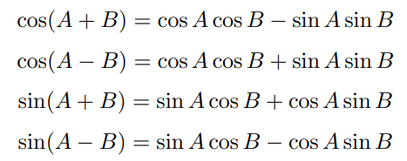
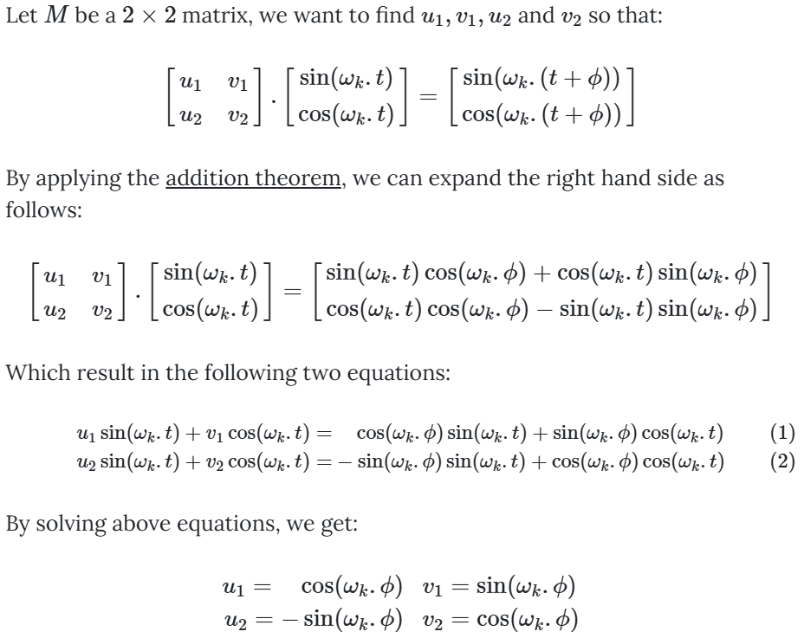
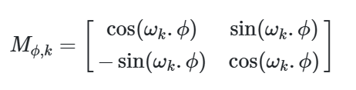
Positional Encodings
https://kazemnejad.com/blog/transformer_architecture_positional_encoding/

Slide 23
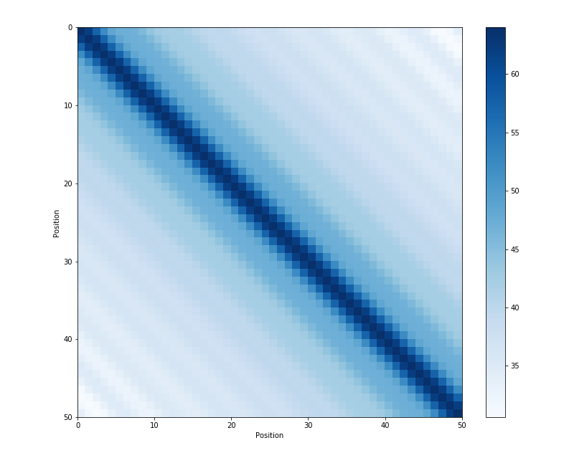
Positional Encodings
The distance between neighboring time-steps is symmetrical

Slide 24
Attention is all you need Step by step

Slide 25
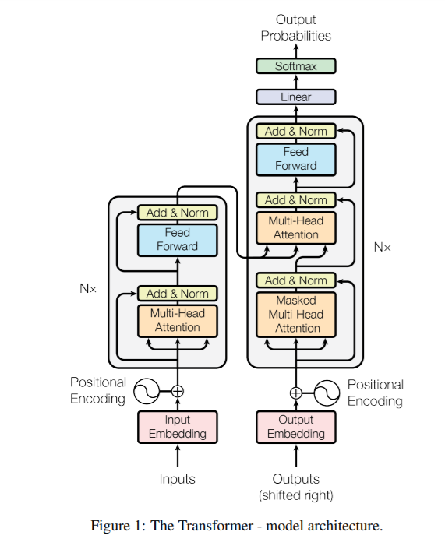
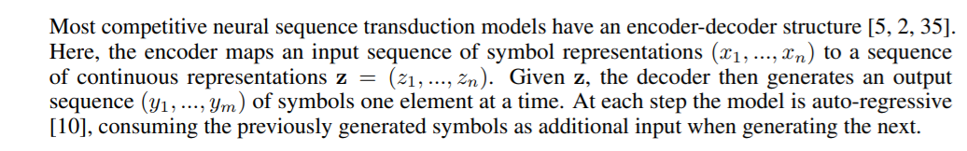
Transformer architecture

Slide 26
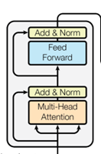
Transformer: encoder block
Multi head attention layer
Layer normalization
Feed forward layer (applied independently to each vector)
Layer normalization
+ Residual connections (before the normalizations)

Slide 27
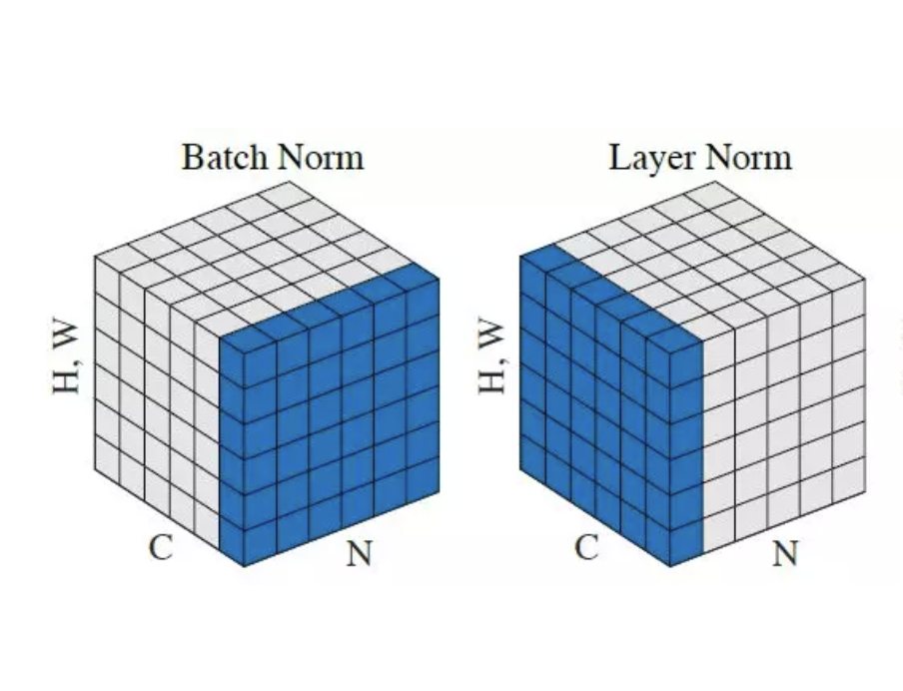
Batch norm vs Layer norm
Layer norm: just like batch norm, but applied on a different dimension
Does not propagate information across time dimension (self attention does this)
Layer norm does not depend on batch size

Slide 28
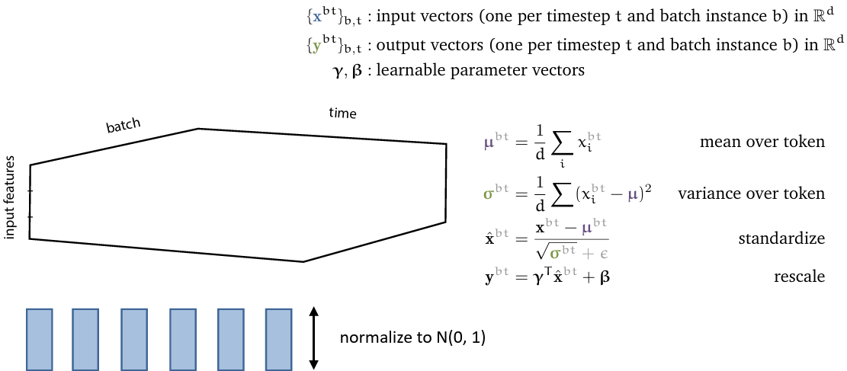
Layer norm

Slide 29
Transformer: encoder block
Multi head attention layer
Layer normalization
Feed forward layer (applied independently to each vector)
Layer normalization
+ Residual connections (before the normalizations)

Slide 30
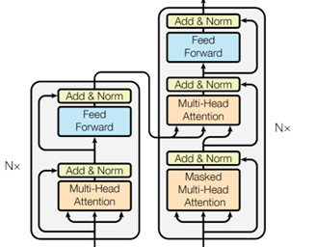
Transformer: decoder block
Input: block on the same level in the encoder and the previous level in the decoder
Masked multi head attention

Slide 31
Attention is all you need (step by step example)
https://youtu.be/Ub3GoFaUcds?t=5421

Slide 32
Other resources
Jay Alammar series on transformers
https://jalammar.github.io/
Let’s build GPT from scratch
https://www.youtube.com/watch?v=kCc8FmEb1nY
State of GPT
https://www.youtube.com/watch?v=bZQun8Y4L2A

Slide 33
An Image is Worth 16x16 Words: Transformers for Image Recognition at Scale
Vision transformer

Slide 34
Official implementation in JAX: https://github.com/google-research/vision_transformer#vision-transformer

Slide 35
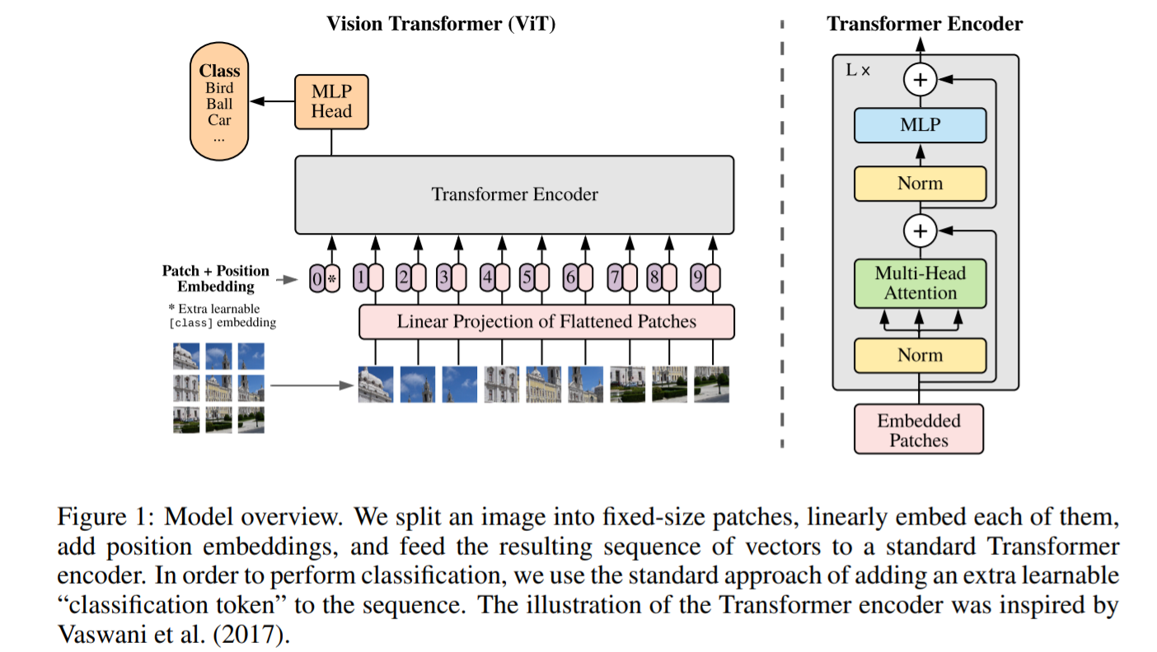
Vision transformer

Slide 36
Vision transformer
The image x ∈ R ^{H×W×C} is transformed into a sequence of flattened 2D patches x_{p} ∈ R^{N×(P2 ·C)}
(P, P) is the resolution of each image patch
sequence length: N = HW/P²
Flatten the patches and map to D dimensions with a trainable linear projection
constant latent vector size D through all of its layers

Slide 37
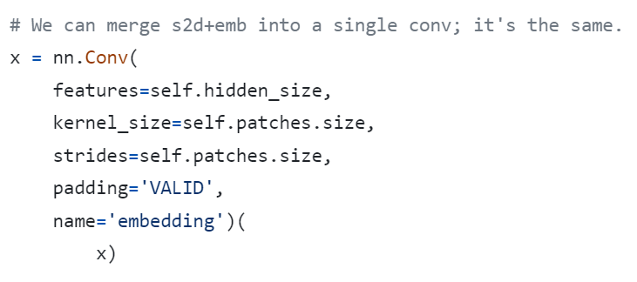
Vision transformer
https://github.com/google-research/vision_transformer/blob/main/vit_jax/models_vit.py

Slide 38

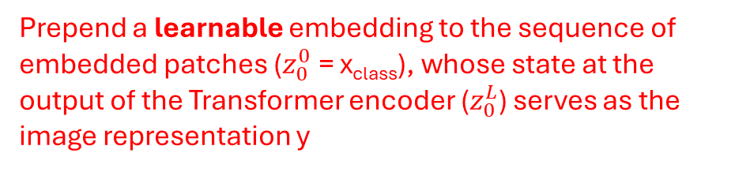
Vision transformer
a classification head is attached to $z_{0}^{L}$
Prepend a learnable embedding to the sequence of embedded patches ($z_{0}^{0}$ = x_{class}), whose state at the output of the Transformer encoder ($z_{0}^{L}$) serves as the image representation y

Slide 39
Position embeddings
A unique learnable vector p_{i} ∈ ℝ^{D} is added to each patch embedding before entering the Transformer encoder.
Embeddings are learned from scratch during training, not hand-crafted.
Each position gets its own independent vector - no inductive bias about proximity.
The special [CLS] token also receives a positional embedding at index 0.
The original ViT paper tested 1D, 2D, and relative positional encodings and found no significant difference in performance. 1D was kept for simplicity.

Slide 40
Position embeddings
Drawbacks?
At test time, if image resolution changes, the number of patches N changes.
Positional embeddings must be interpolated (bicubic), which causes a performance drop.

Slide 41
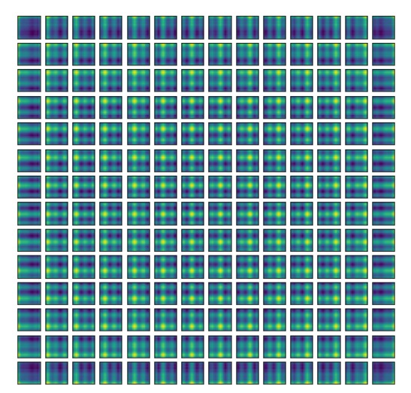
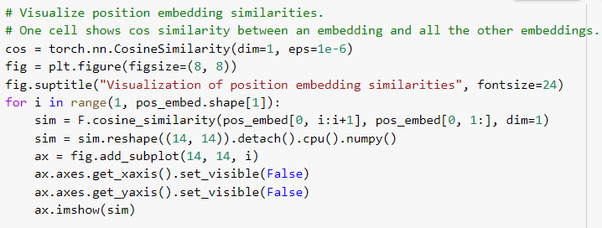
Position embeddings visualisation
for each patch position i, computes the cosine similarity between that position's embedding and all other positions' embeddings
pos_embed shape: (1, 197, D)

Slide 42
Position embeddings visualisation
reshape the result into a 14×14 grid (matching the spatial layout of the patches) and plot it as a heatmap

Slide 43
Position embeddings visualisation
the bright spot in each cell tends to be localised around the cell's own position, and similarity falls off with distance.

Slide 44
Position embeddings
Even though ViT uses 1D learnable positional embeddings (no explicit 2D structure), the model learns 2D spatial structure: nearby patches develop similar embeddings.
There's also a visible row/column pattern (grid-like structure in some cells) -> the model learns both horizontal and vertical proximity.

Slide 45
Vision transformer
0, 1, 2, …
Position embeddings are added to the patch embeddings to retain positional information.
(standard learnable 1D position embeddings)

Slide 46
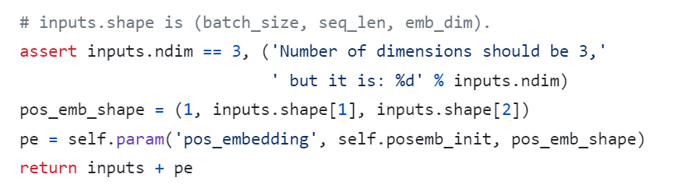
Vision transformer
https://github.com/google-research/vision_transformer/blob/main/vit_jax/models_vit.py

Slide 47
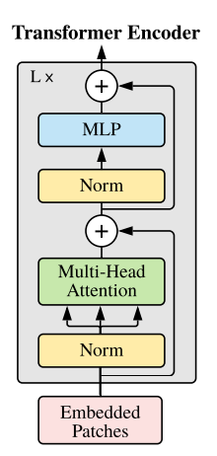
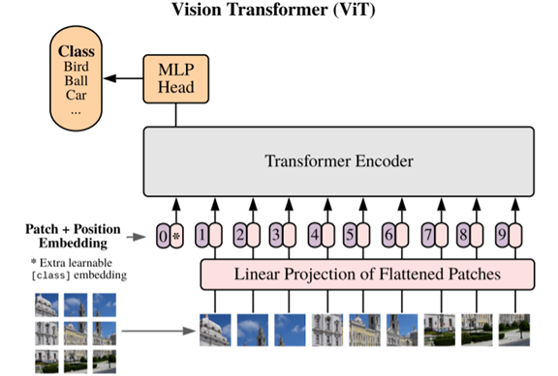
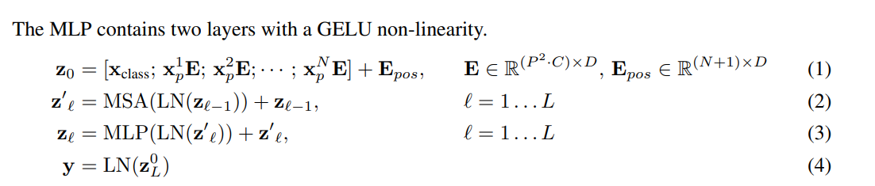
Vision Transformer
The Transformer encoder consists of alternating layers of multiheaded self-attention and MLP blocks.

Slide 48
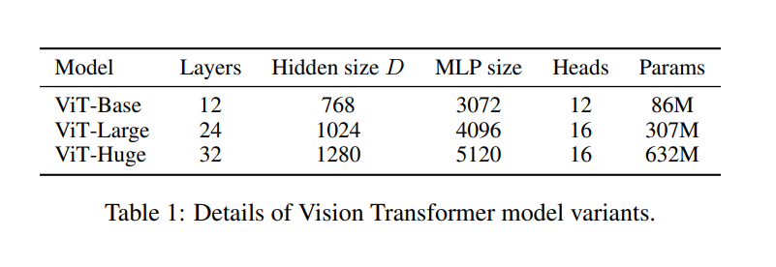
Vision Transformer
Hidden size D embedding dimension: the size of every token vector as it flows through the entire Transformer.
after the self-attention, there is a 2-layer MLP (equations 3 from the paper). The MLP size is the dimension of the hidden layer inside that MLP (4x)

Slide 49
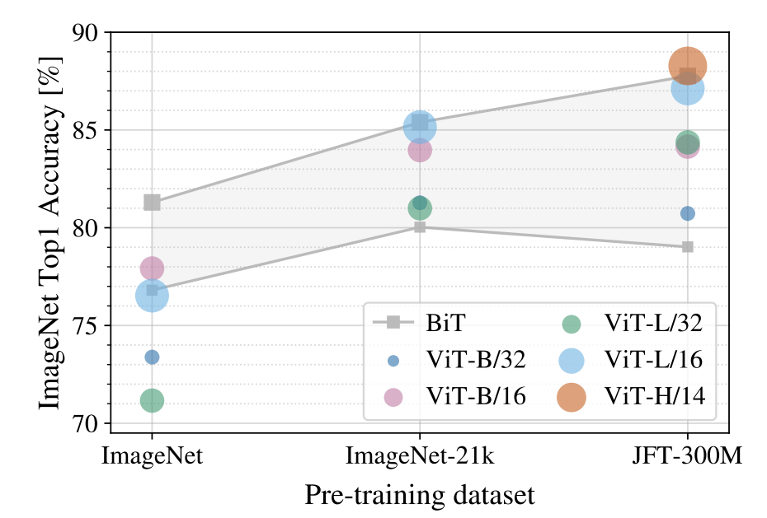
B = Base
L = Large
H = Huge
/32, /16, /14 is patch size; smaller patch size is a bigger model (more patches)
BiT – modified Resnet architecture
Imagenet: 1.2M images, 1k classes
ViT models perform worse than ResNets ☹

Slide 50
B = Base
L = Large
H = Huge
/32, /16, /14 is patch size; smaller patch size is a bigger model (more patches)
BiT – modified Resnet architecture
ImageNet-21k: 14M images, 21k categories
pretrain on ImageNet-21k and fine-tune on ImageNet
big ViTs match big ResNets

Slide 51
B = Base
L = Large
H = Huge
/32, /16, /14 is patch size; smaller patch size is a bigger model (more patches)
BiT – modified Resnet architecture
JFT - 300M internal Google dataset with 300M images
pretrain on JFT and fine-tune on ImageNet
large ViTs outperform large ResNets

Slide 52
DeIT
Training data-efficient image transformers & distillation through attention
https://arxiv.org/abs/2012.12877

Slide 53
Knowledge distillation
Teaching a student intern:
Standard training: Give them the documentation and let them figure it out alone
Distillation: Have an experienced expert work alongside them, sharing their reasoning and intuitions, not just the final answers
Knowledge distillation is the machine learning version of the second approach.
large, powerful teacher model (already well-trained)
train a smaller or weaker student model to mimic the teacher
The student learns from both the ground-truth labels and the teacher's behaviour

Slide 54
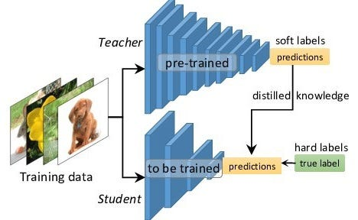
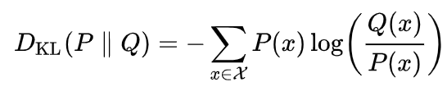
Knowledge distillation
Step 1: Train a teacher model on images and ground-truth labels (cross entropy loss)
KL divergence loss
(knowledge distillation loss)
You can also use standard CE loss
Step 2: Train a student model to match predictions from the teacher
https://pub.towardsai.net/a-gentle-introduction-to-knowledge-distillation-6240bf8eb8ea

Slide 55
“Dark knowledge”
The teacher's probability distribution carries hidden knowledge:
Inter-class similarity: the model has learned that Huskies and Malamutes are visually close
Uncertainty information: when the teacher is unsure, the student learns to be unsure too
Error structure: the pattern of which classes get confused encodes real visual relationships
Introduced by G. Hinton. Idea: the small probabilities on wrong classes are not noise, they are meaningful
This is sometimes called the "dark knowledge" in the teacher: information that exists in the model but never appears in the training labels.

Slide 56
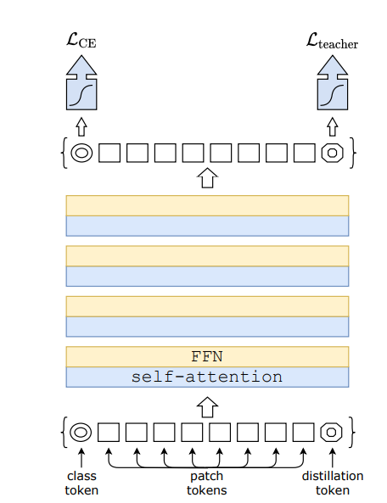
DeIT Data-efficient Image Transformers
Train a teacher CNN on ImageNet
Train a student ViT to match ImageNet predictions from the teacher CNN and match GT labels
https://arxiv.org/abs/2012.12877

Slide 57
DeIT Data-efficient Image Transformers
Predicted class scores; should match labels
Use CE loss
Predicted class scores; should match teacher output
https://arxiv.org/abs/2012.12877

Slide 58

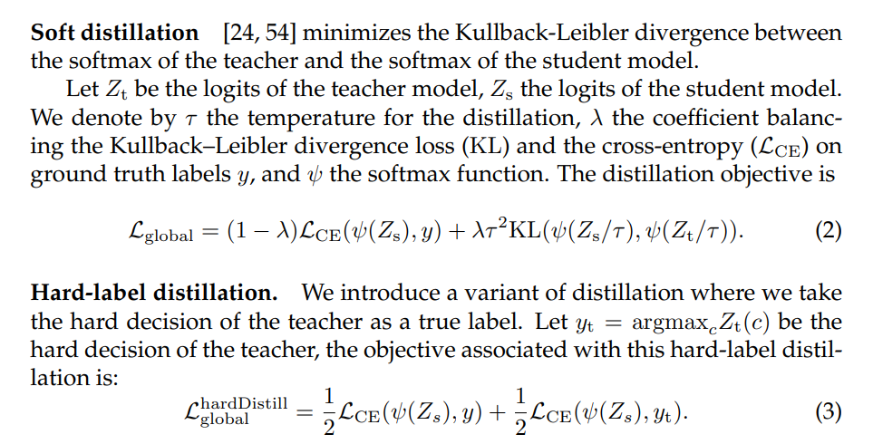
Soft-label vs Hard-label distillation
Softmax with temperature:

Slide 59
DeiT – augmentation and regularization
Beyond distillation, DeiT uses aggressive data augmentation and regularization to prevent overfitting on ImageNet:
RandAugment: random color, shear, rotation transforms
Mixup
CutMix
Random Erasing
Label Smoothing
Stochastic Depth

Slide 60
DeiT – augmentation and regularization
Beyond distillation, DeiT uses aggressive data augmentation and regularization to prevent overfitting on ImageNet:
RandAugment: random color, shear, rotation transforms
Mixup: blend two images and interpolate their labels
CutMix : paste a patch from one image onto another
Random Erasing: randomly mask out a region of the image
Label Smoothing: soften one-hot targets slightly
Stochastic Depth: randomly drop transformer layers during training

Slide 61
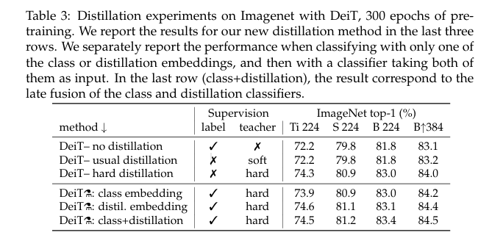
DeIT Data-efficient Image Transformers

Slide 62
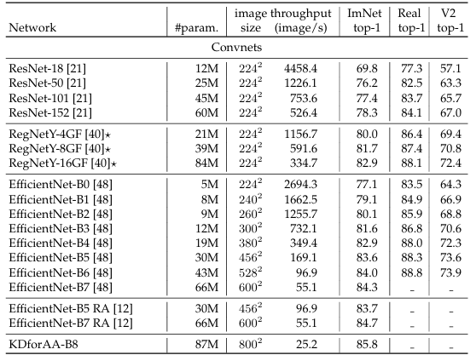
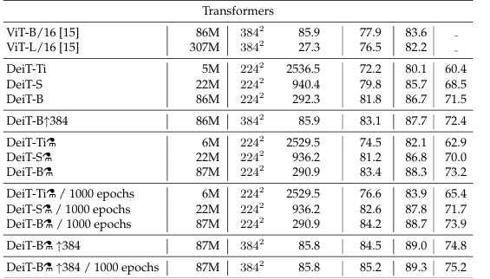
DeIT Data-efficient Image Transformers

Slide 63
DeIT Data-efficient Image Transformers
Always check Real and V2 columns, not just ImageNet top-1
DeiT-B distilled matches EfficientNet-B5 at 3x the params but higher throughput
At 384² DeiT surpasses every CNN in the table
The * RegNet models are the actual teacher models used: DeiT matches its own teacher
Resolution boosts accuracy but kills throughput: EfficientNet-B7 runs at 55 img/s vs DeiT's 290 img/s

Slide 64
DeIT Data-efficient Image Transformers
You no longer need Google-scale data to train a competitive ViT
Standard academic GPU clusters are sufficient
Transformers can match CNNs with the right training strategy

Slide 65
Swin Transformer
SwinTransformer: Hierarchical Vision Transformer using Shifted Windows

Slide 66
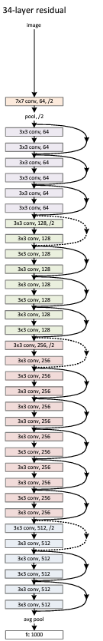
SWIN Transformer
CNNs – hierarchical architecture
Decrease resolution and increase channels as you go deeper in the network
ViT – isotropic architecture
all blocks have same resolution and number of channels

Slide 67
SWIN Transformer
ViT and DeiT bottlenecks
Every patch token attends to every other patch token: global self-attention
For an image of N patches, this costs O(N²) in memory and computation
A 224×224 image with 16×16 patches = 196 tokens: manageable
A 512×512 image with 16×16 patches? = 1,024 tokens: 25× more expensive
This makes ViT impractical for high-resolution vision tasks like object detection and segmentation

Slide 68
SWIN Transformer
Compute attention only within local windows, not globally
Use a hierarchical structure like CNNs (feature maps at multiple scales)
Connect windows across layers using a shifting mechanism

Slide 69
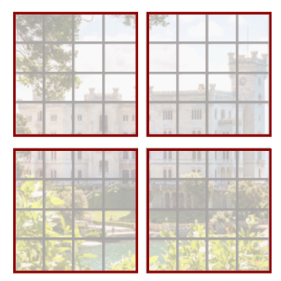
SWIN Transformer
With H x W grid of tokens, each attention matrix is quadratic in image size H²x W²
Swin transformer computes self-attention locally within M non-overlapping windows that partition an image
Split image into M windows (M=4 in this example)
Only compute attention within each window

Slide 70
SWIN Transformer
Global Attention
Feature map: h × w × C
Global attention: every patch attends to every other patch
Total patches: hw
Complexity: O((hw)²): quadratic in image size
Window-Based Attention
Divide into non-overlapping M×M windows
Number of windows: hw/M²
Each window has M² patches: attention stays local
Complexity: O(hw) — linear in image size

Slide 71

SWIN transformer
Operation | Global | Window
Q, K, V projections | 3hwC² | 3M²C²
QKᵀ | (hw)²C | M⁴C
Softmax(QKᵀ)V | (hw)²C | M⁴C
Final projection | hwC² | M²C²
Ω(MSA)=4hwC²+2(hw)²C
$$Ω\left(\text{W}\text{−}\text{MSA}\right)=4hwC^{2}+2M^{2}hwC$$

Slide 72
SWIN Transformer
A patch in one window cannot attend to a patch in another window
Problem: imagine a dog that spans two windows: the left half and the right half are never compared. The model cannot reason about objects that cross window boundaries, and it cannot build up global context.
Solution
SHIFTED WINDOWS

Slide 73
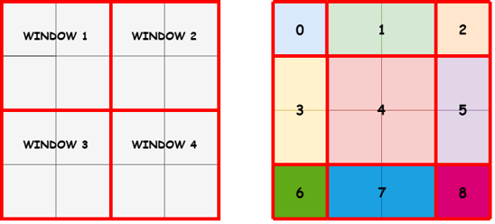
SWIN Transformer
(a) regular window partitioning VS (b) shifted window partitioning for a 4 ✕ 4 feature map with 2 ✕ 2 windows of size 2 ✕ 2 (M = 2)
(b)The window grid has been shifted by 1 patch (M/2 = 1) toward the top-left

Slide 74
SWIN Transformer
Shifting creates partial windows at the edges: smaller than M×M
Number of windows grows from ⌈h/M⌉ × ⌈w/M⌉ to (⌈h/M⌉ + 1) × (⌈w/M⌉ + 1)
More windows + irregular sizes = inefficient computation
Naïve fix
Pad partial windows back up to M×M
Simple, but adds unnecessary computation on padding tokens
Real fix:
Cyclically roll the feature map toward the top-left. This fills the partial edge windows using pixels wrapped from the opposite side
All windows are now exactly M×M: no padding needed

Slide 75
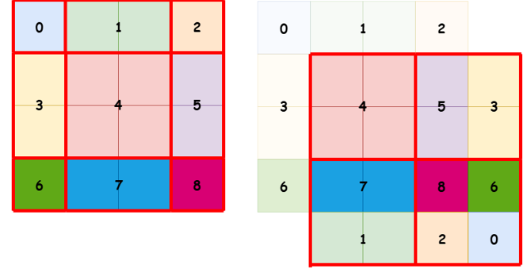
SWIN Transformer – cyclical shift

Slide 76
SWIN Transformer – cyclical shift
The entire feature map has been rolled toward the top-left by 1 patch
Region 0 (was top-left corner): wrapped to bottom-right
Regions 1, 2 (were top row): wrapped to bottom row
Regions 3, 6 (were left column): wrapped to right column
Region 8 is now attending alongside regions 6, 2, 0 in the same window even though they are not actually spatial neighbours in the original image.

Slide 77
SWIN Transformer – cyclical shift
Wrapped pixels are not real spatial neighbours
Allowing them to attend to each other would create false relationships
Solution: apply an attention mask so wrapped regions cannot attend to each other
After attention, the feature map is rolled back to its original position

Slide 78
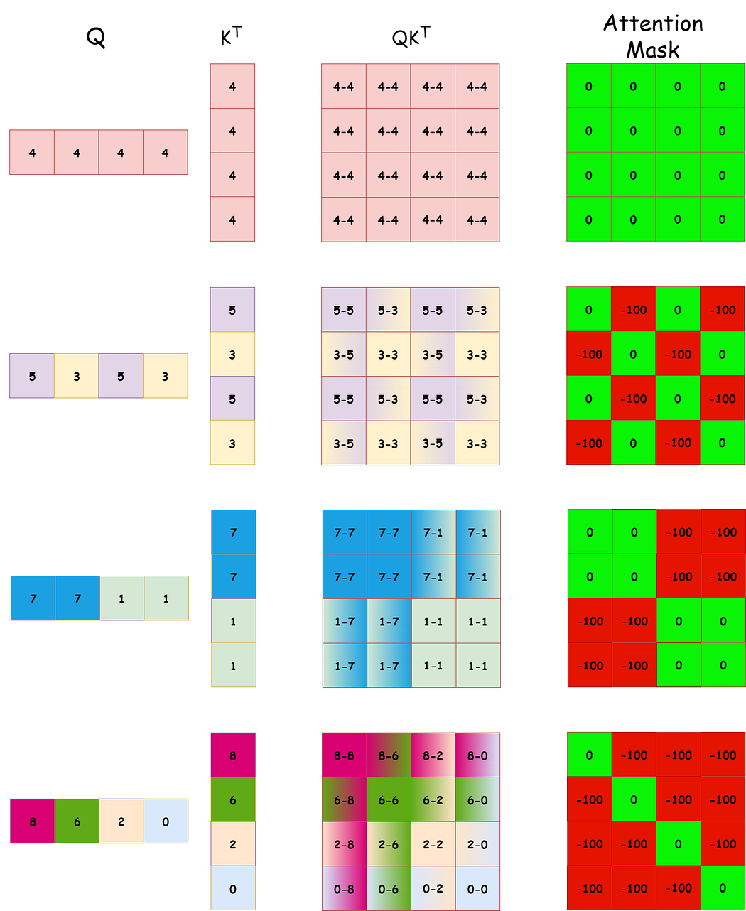
SWIN Transformer - cyclical shift

Slide 79
SWIN Transformer – cyclical shift
If a connection is valid, the mask value is 0, meaning it does not affect the SoftMax computation.
If a connection is artificial, the value of the mask will be -100 (or another very small value), causing the SoftMax function to assign it a negligible probability

Slide 80
SWIN Transformer
The window-based self-attention module lacks connections across windows, which limits its modeling power.
No interaction with tokens outside the window
Solution: alternate between normal and shifted in alternative transformer blocks in the architecture

Slide 81
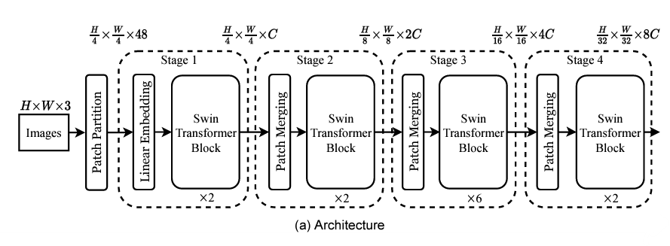
SWIN Transformer
Divide image into 4x4 patches and project to C dimensions
https://arxiv.org/abs/2103.14030

Slide 82
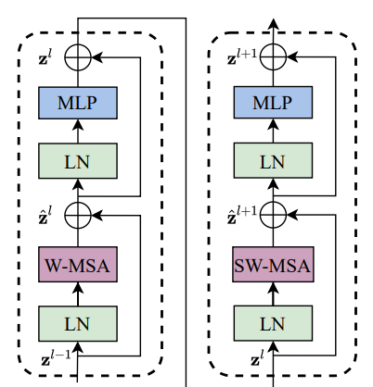

SWIN Transformer
- where ẑ^{l} and z^{l} denote the output features of the (S)WMSA module and the MLP module for block l

Slide 83
SWIN Transformer
Divide image into 4x4 patches and project to C dimensions
SWIN transformer block
Merge patches in neigh. 2x2, patches are 8x8
https://arxiv.org/abs/2103.14030

Slide 84



SWIN Transformer
Linear projection (1x1 conv)
“The first patch merging layer concatenates the features of each group of 2×2 neighboring patches, and applies a linear layer on the 4C-dimensional concatenated features.
This reduces the number of tokens by a multiple of 2×2=4 (2× down sampling of resolution), and the output dimension is set to 2C”
https://arxiv.org/abs/2103.14030

Slide 85


SWIN Transformer
Other details
Cyclic shifting and masked attention
Encodes relative position between patches when computing attention

